Slide 1
On the Novelty of Ours
Presenter: Kim Seung Hwan (seunghwan.kim@snu.ac.kr)

Slide 2
Contents
A brief survey of several papers
Personal thoughts on our novelty
Experiment

Slide 3
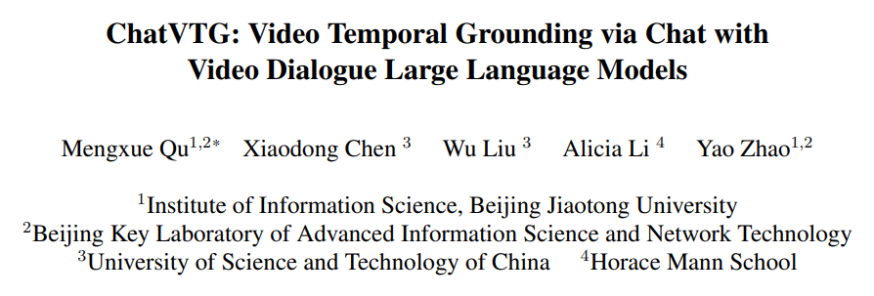
ChatVTG
CVPR 2024

Slide 4
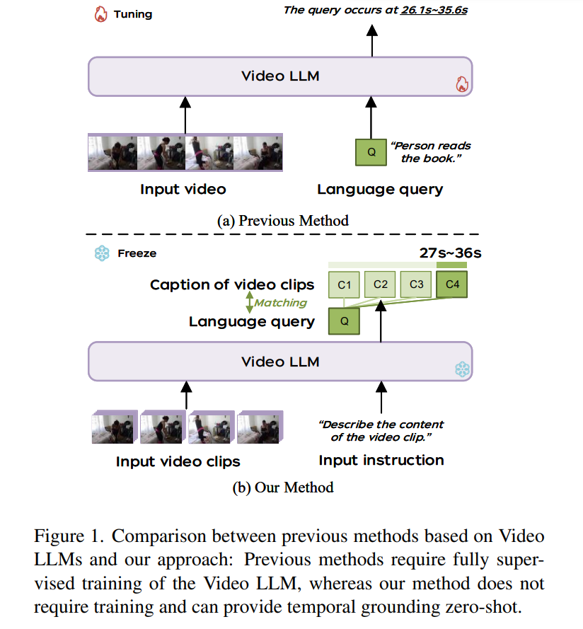
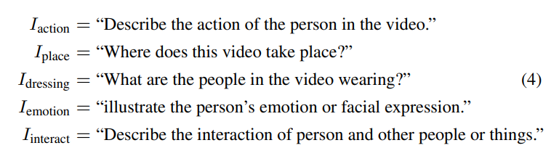
ChatVTG
Zero shot VTG
Split into equal-length clips (short videos) and caption them via VLM
Matching captions and query sentence via LLM

Slide 5
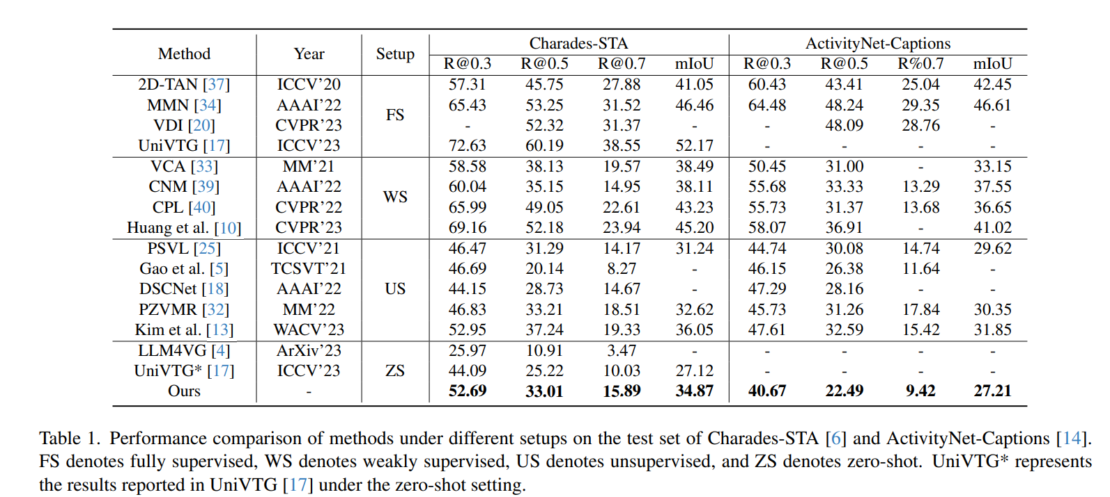
ChatVTG

Slide 6
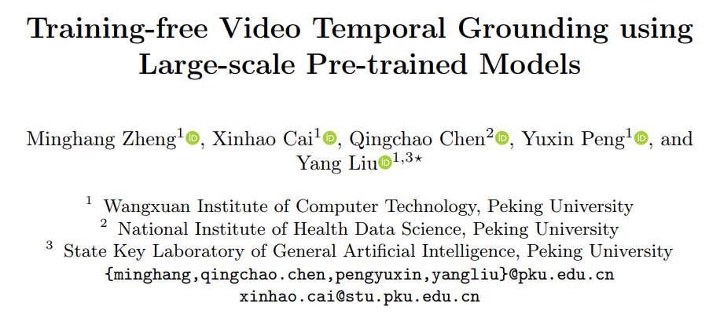
TFVTG
ECCV 2024

Slide 7
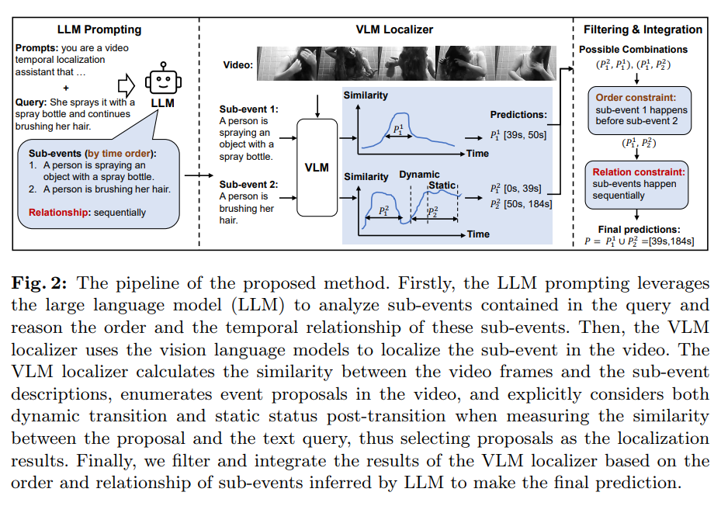
TFVTG
Zero shot, using Query-Frame similarity attained by BLIP-2
Sophisticated pre/post-processing
Query decomposition by LLM
Static/Dynamic part
Forming relation by LLM
Can be seen over-engineered

Slide 8
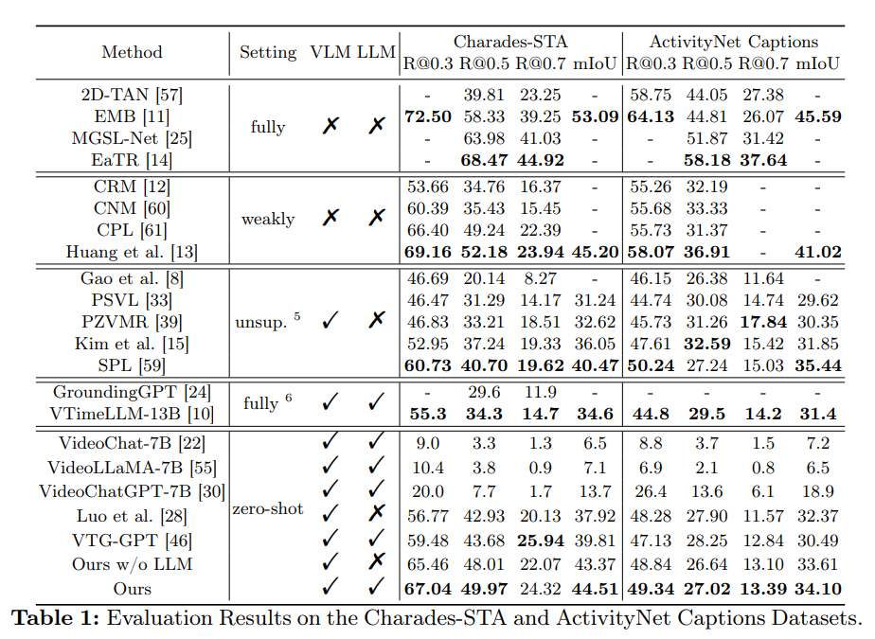
TFVTG
SOTA

Slide 9
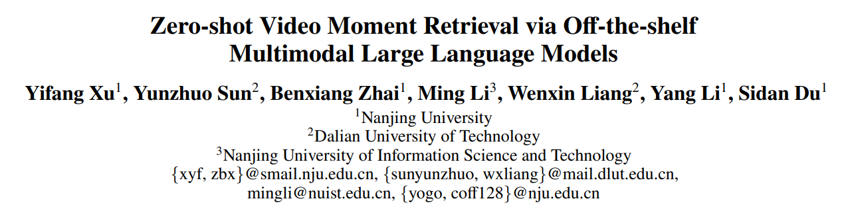
Moment-GPT
AAAI 2025

Slide 10
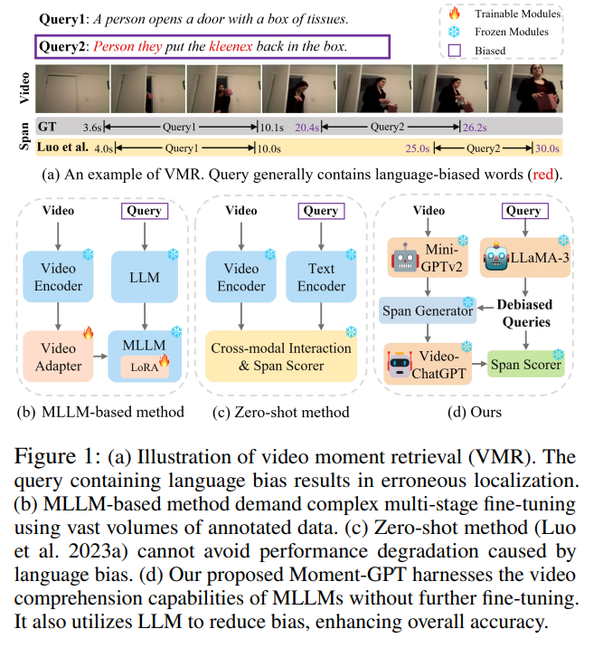
Moment-GPT
Zero shot, multi agent
Generate frame caption by Mini-GPTv2
Generate debiased query by LLaMA-3
Span Generator is an algorithm (not NN)
Generate clip caption by Video-ChatGPT
Span Scorer is simply caption-caption matching by LLaMA-3

Slide 11
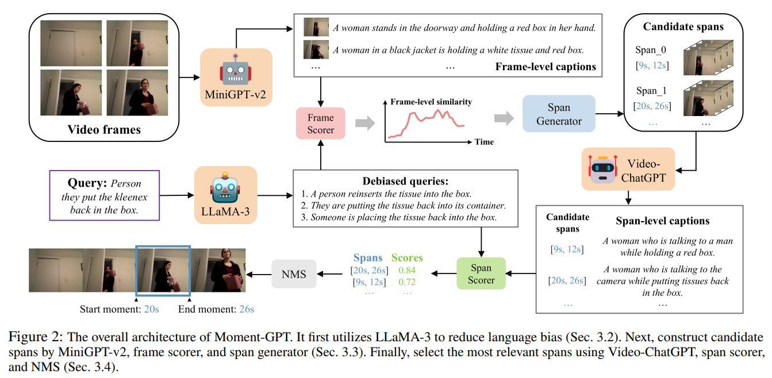
Moment-GPT

Slide 12
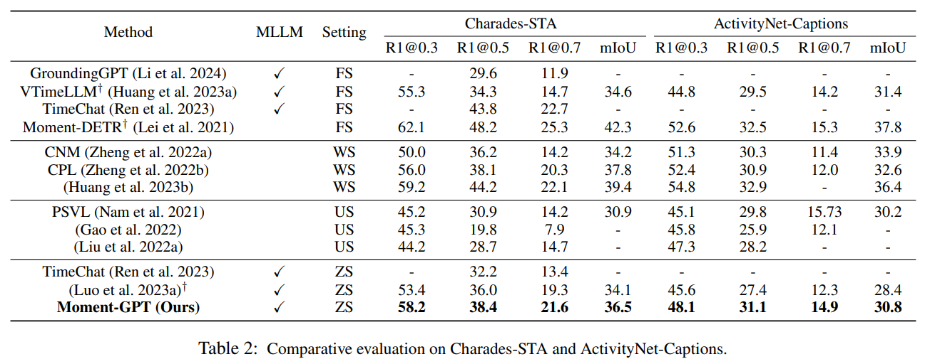
Moment-GPT
Too bad,
Considering the use of a lot of models

Slide 13
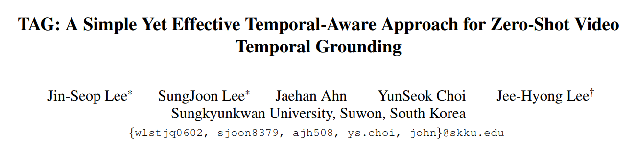
TAG
Arxiv paper
But it’s 2508

Slide 14
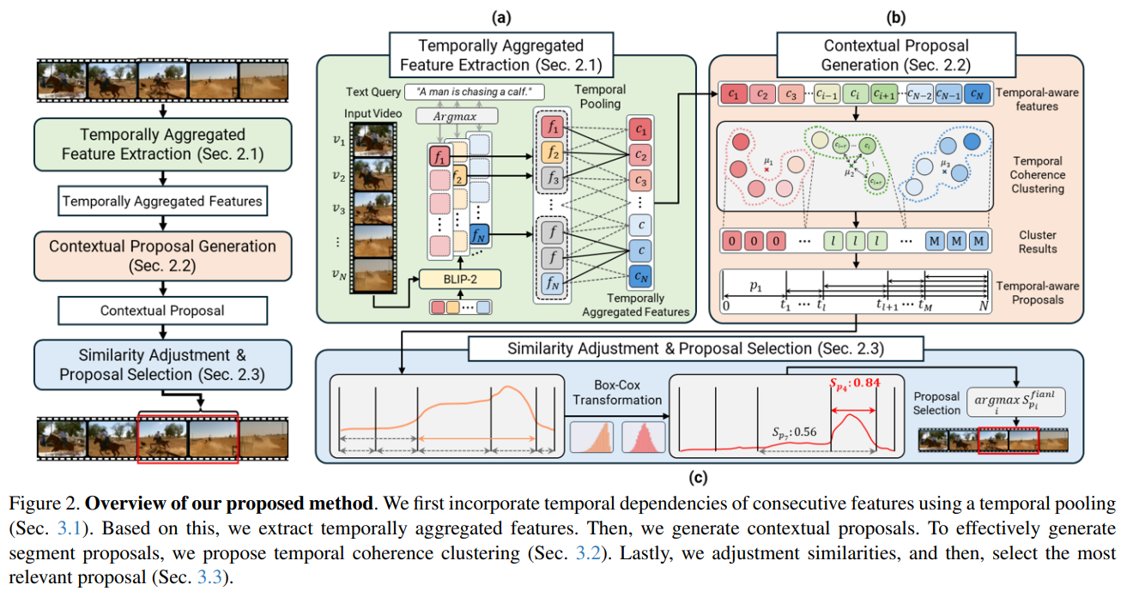
TAG
Zero shot, using frame-wise feature from BLIP-2
Explicit temporal pooling
Engineered post-processing

Slide 15
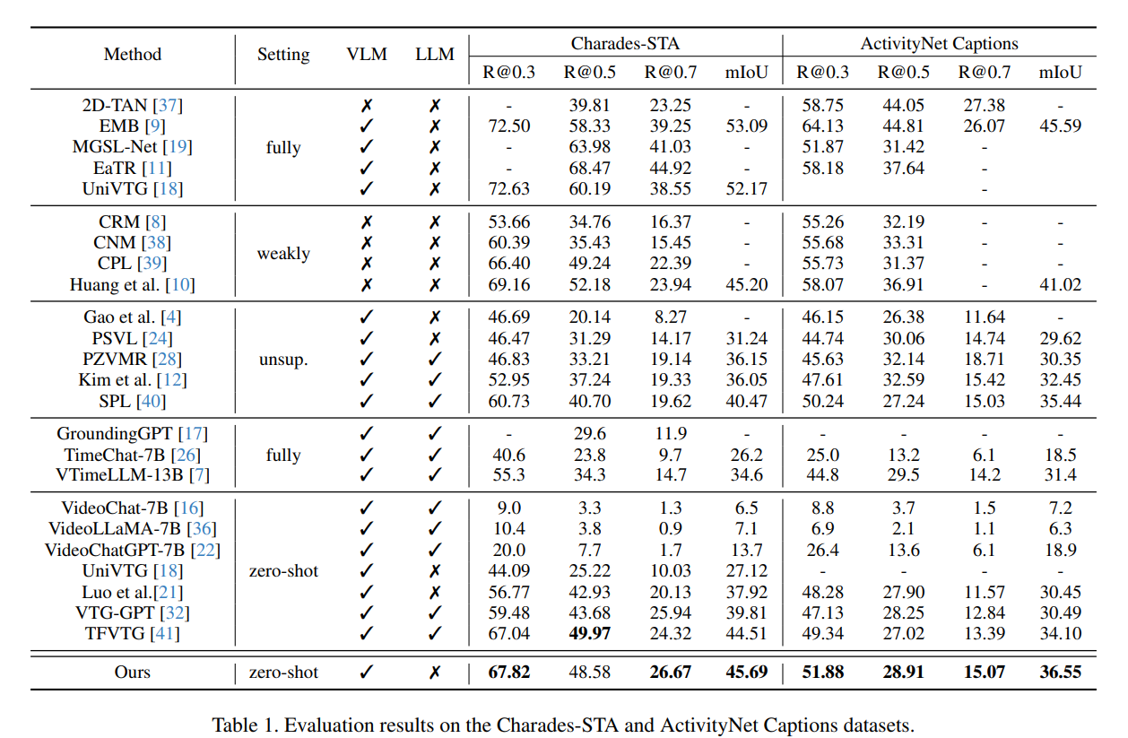
TAG
SOTA

Slide 16
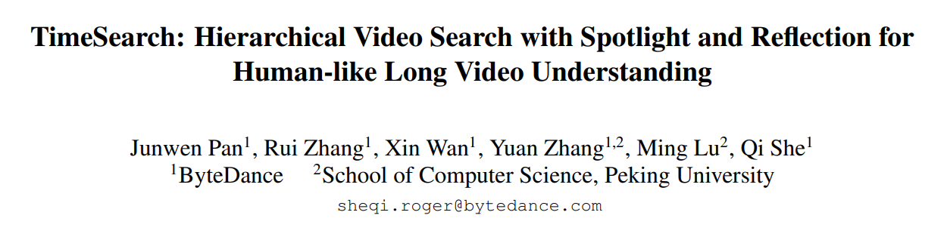
TimeSearch
Arxiv paper (2502)
From industry (ByteDance)

Slide 17
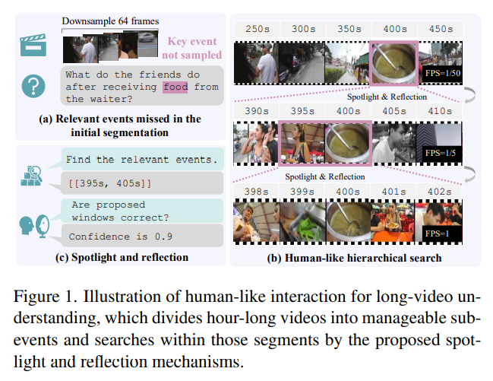
TimeSearch
For long video, requires training
Splitting a video into clips reduces cognitive overhead, e.g., tokens
Clip scoring, and exploring spans greedily and recursively
Very similar to ours, but it explicitly separates span extraction from confidence prediction
It uses an alternative timestamp encoding, requiring training

Slide 18
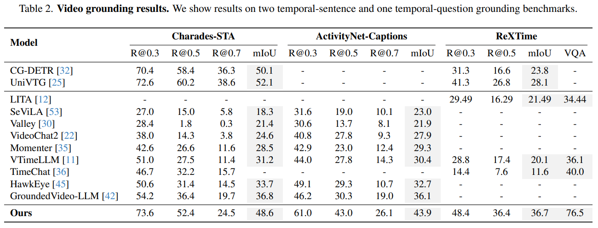
TimeSearch
SOTA

Slide 19
Other Long Video Approachs…
CoS
ReVisionLLM
EventFormer
And more…
Whether a uniform length or a semantic unit, spliting it into clips is very common in long video tasks

Slide 20
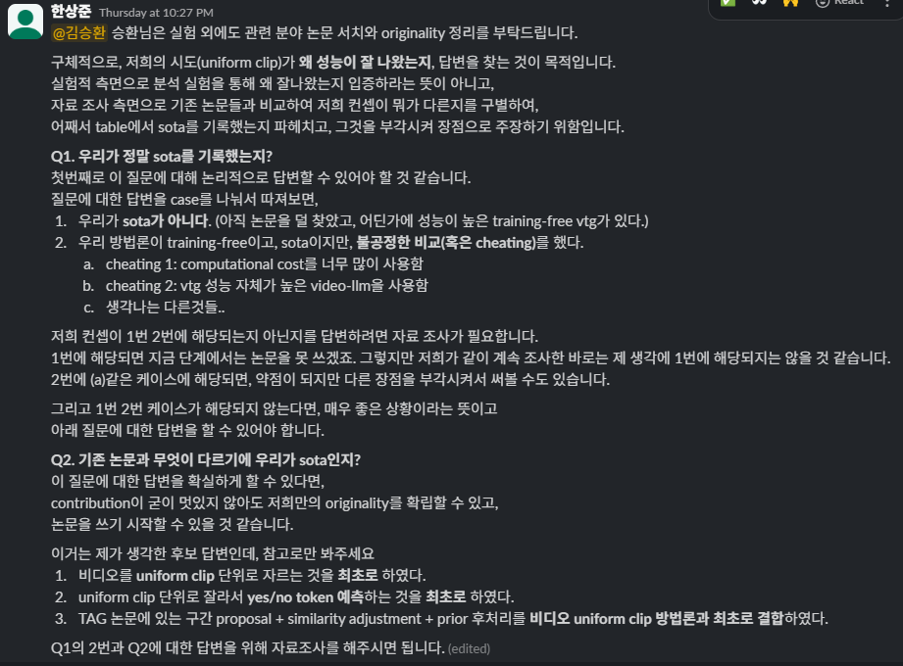
Novelty

Slide 21

Novelty
I could not find any study similar to our concept, using clip score for short video VTG
Is cost an issue? Probably not
There have been many expensive methods
Also, our backbone cannot resolve VTG task with an entire video

Slide 22
Novelty
Scoring frames is very common in VTG task
Developing this to scoring clips seems like a natural approach, so we are sure there are already been some prior works on this

Slide 23
Novelty
But I found that our method was more geared towards niche tasks than natural ones
In short video VTG, one can insert the entire video
e.g, NumPro, we focused on, simply uses Charades-STA with 2 FPS
On the other hand, when training is allowed, studies focus on temporal understanding, using the entire video
On the one hand, in long video VTG, the use of clips is very common

Slide 24
Novelty
Our target, zero-shot short video VTG, can be seen as lying somewhere in between
In terms of cost, one can use the entire video
However, semantically, it is similar to long video case, the model struggles to understand timestamp values or temporal order
Of course, video VLM understands actions better than CLIP or BLIP!
Our method exploits this subtlety well

Slide 25
Novelty
In short, our method is, perhaps, the first zero-shot short video VTG evaluated by VLM on clip-wise
I suspect this natural approach is not used for the following reasons:
In short video VTG, video VLMs typically utilized the entire video
Only in long video VTG, splitting into clips is common
Zero-shot VTG is a tricky position between the two
Zero-shot video VLMs, while unaware of timestamp values, are far superior to CLIP or BLIP similarity in action understanding

Slide 26
Novelty
Therefore, if the method remains the same, I think the following motivation and analysis experiments can enhance the novelty:
Since it is zero-shot, it makes sense to clip-wise inference even in short video task, which was only used in long video task
Zero-shot video VLMs are very good at action detection, though they do not know timestamp
e.g., we can test whether the model consistently scores well on clips containing some GT
There may be certain query types where our method is superior to prior frame-wise works

Slide 27
Experiment
Our method divides each video into 10 clips, which is very sparse
What would the result be if we inference it denser?

Slide 28
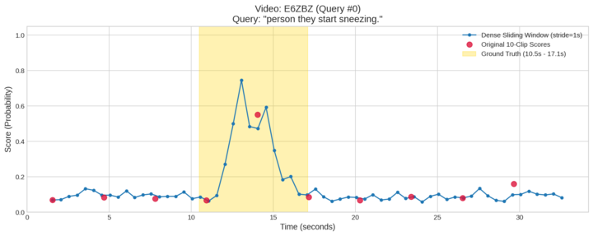
Experiment
Our method divides each video into 10 clips, which is very sparse
What would the result be if we inference it denser?

Slide 29
Experiment
As expected, R@0.7 improves
However, R@0.5 decreases, likely due to noise
In any case, the interpolation version performs the best
While it would be helpful to conduct an ablation study for the writing, the method does not appear to require significant changes
 | R@0.3 | R@0.5 | R@0.7
Dense | 0.7460 | 0.4875 | 0.2428
Sparse (10) | 0.7661 | 0.5022 | 0.2285
Sparse with interpolation | 0.7849 | 0.5946 | 0.3116

Slide 30
Thank you for listening
Presenter: Kim Seung Hwan (seunghwan.kim@snu.ac.kr)

